Slide 1


응급처치와 심폐소생술
자동제세동기의 사용

Slide 2

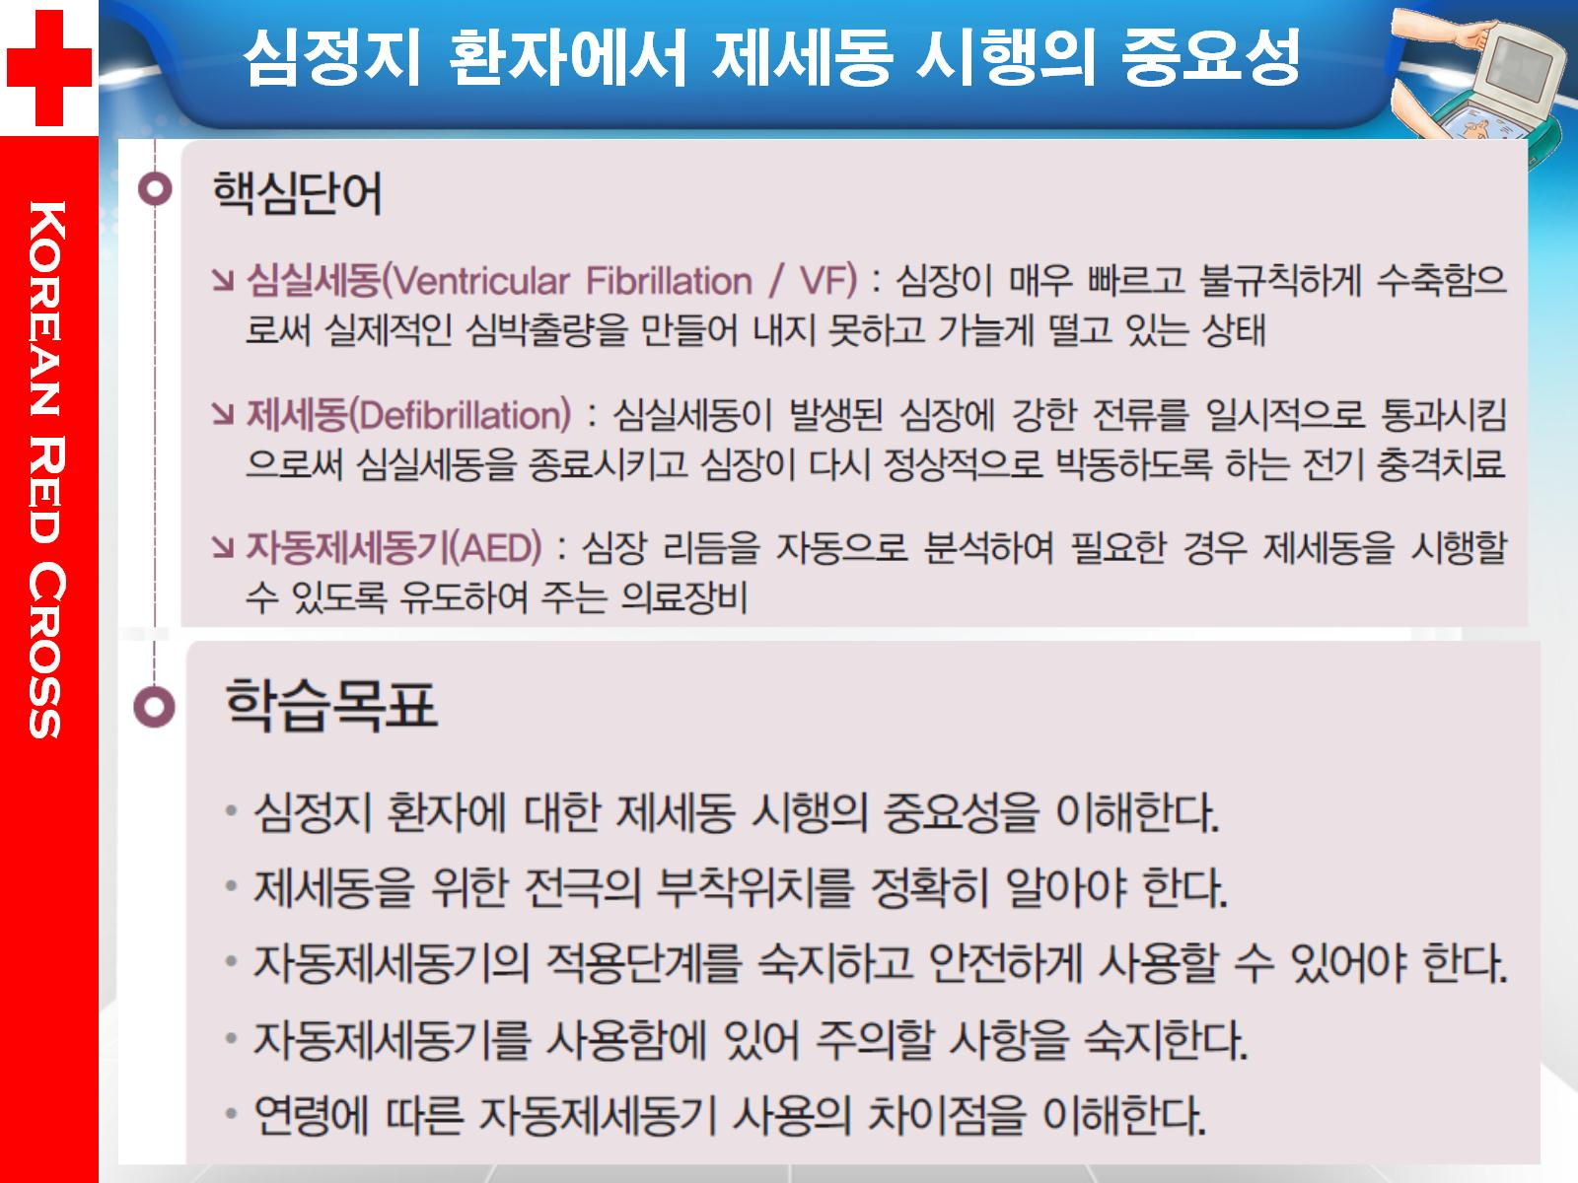


AKorean Alpine Federation
ANation Civil Defense

Slide 3
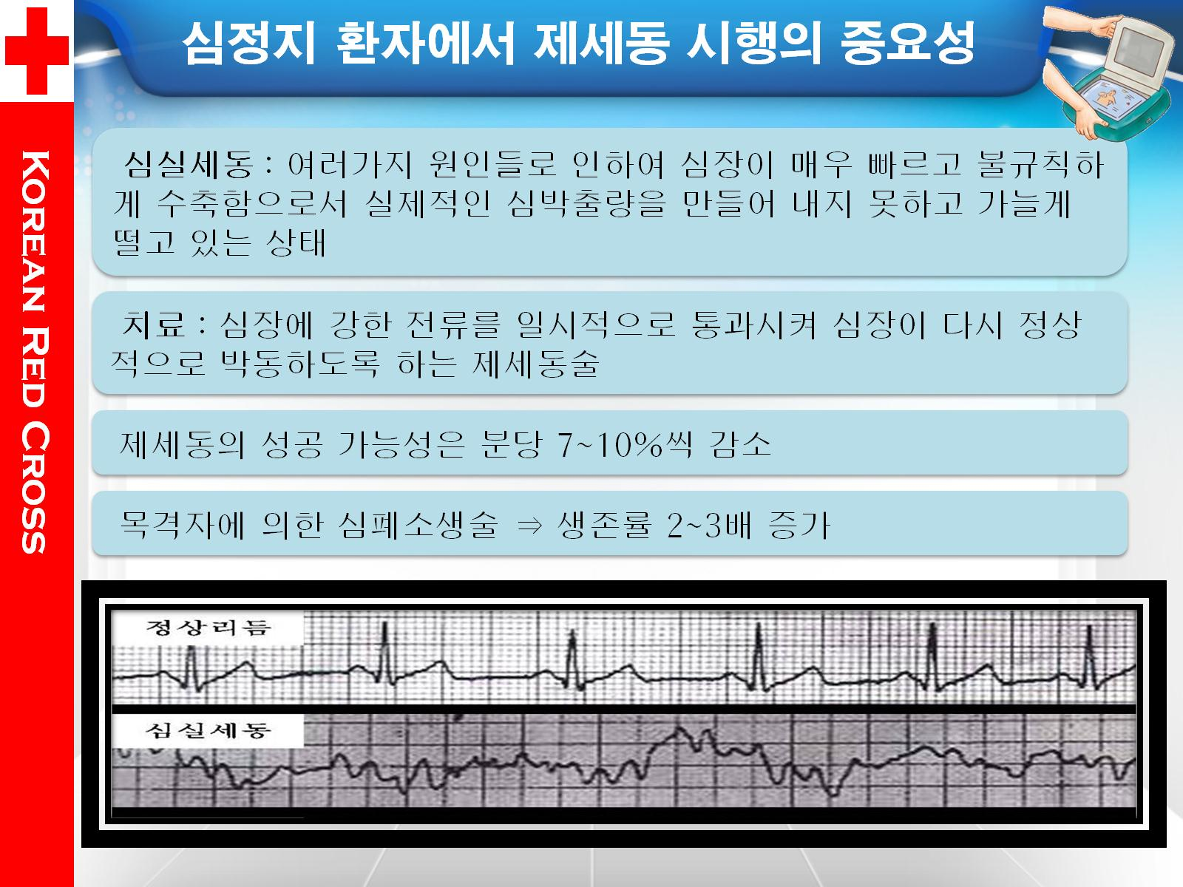
AKorean Alpine Federation
ANation Civil Defense

Slide 4
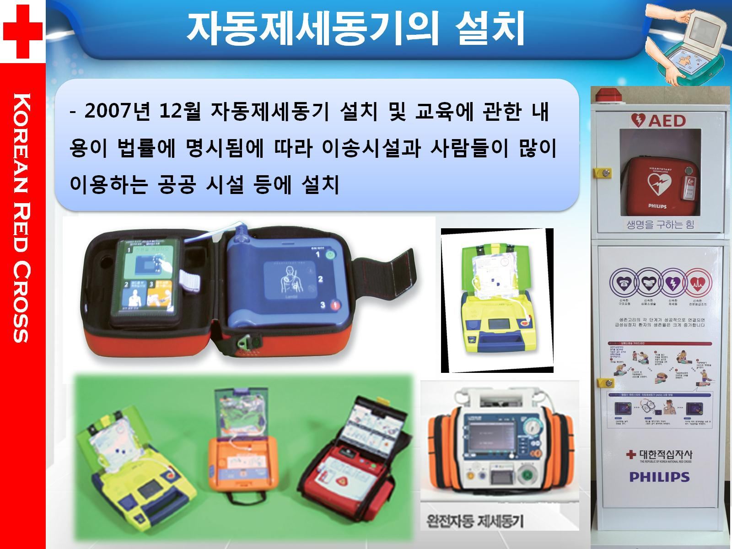
AKorean Alpine Federation
ANation Civil Defense

Slide 5
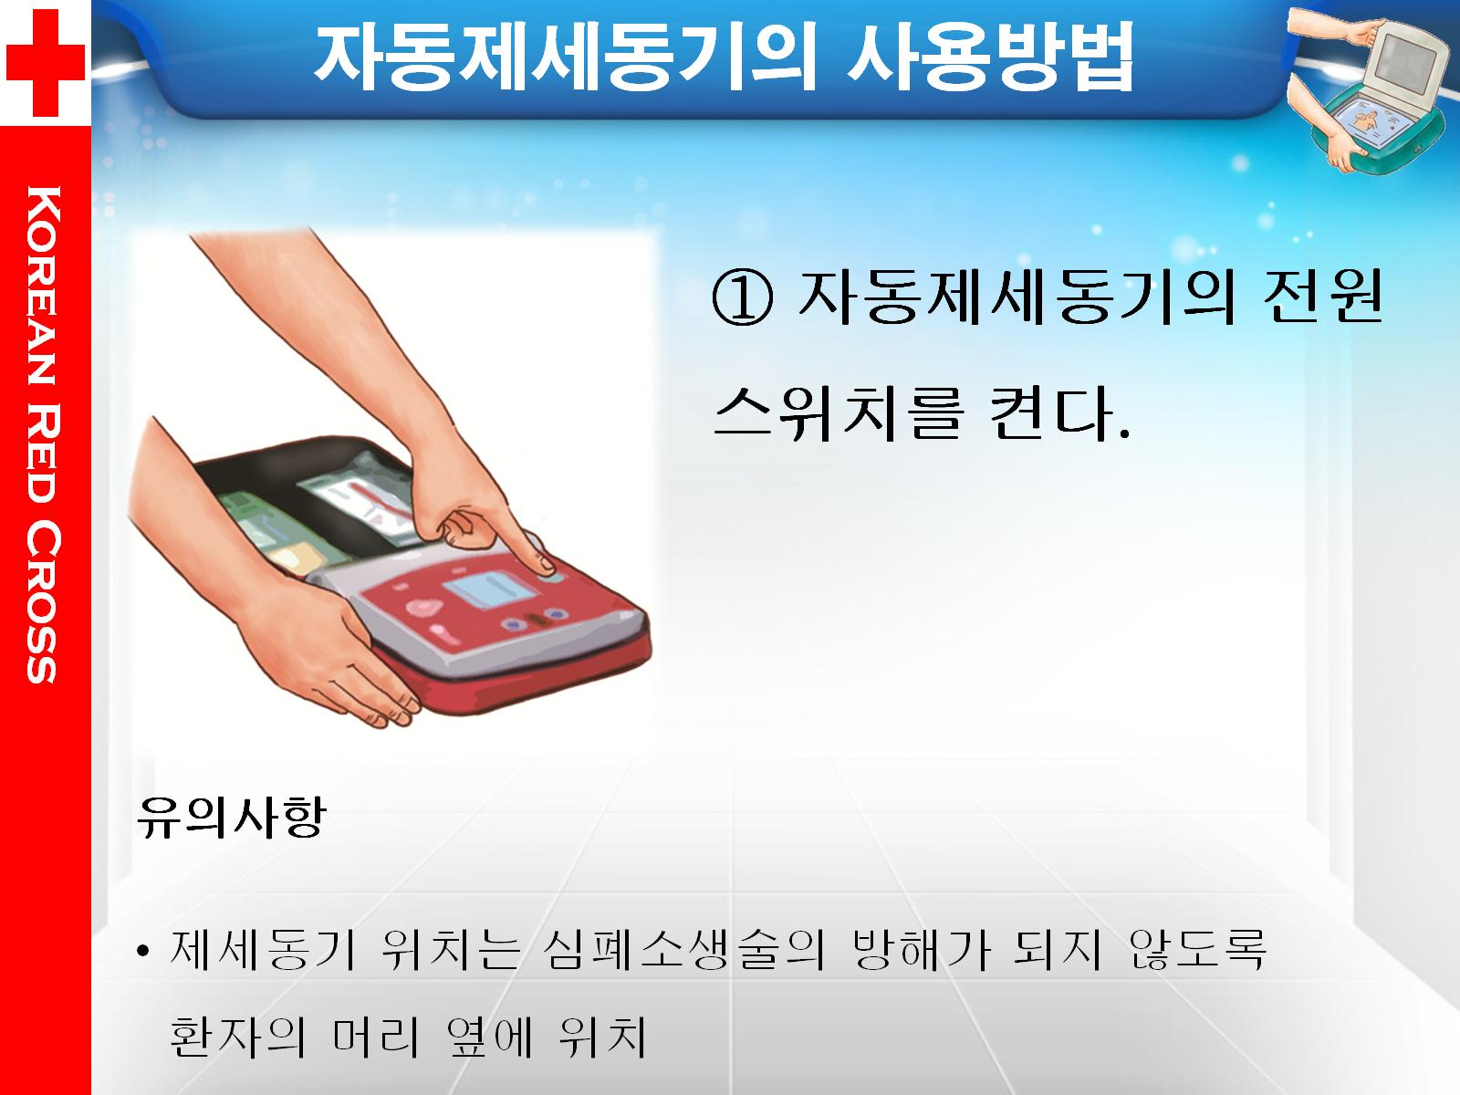
AKorean Alpine Federation
ANation Civil Defense

Slide 6
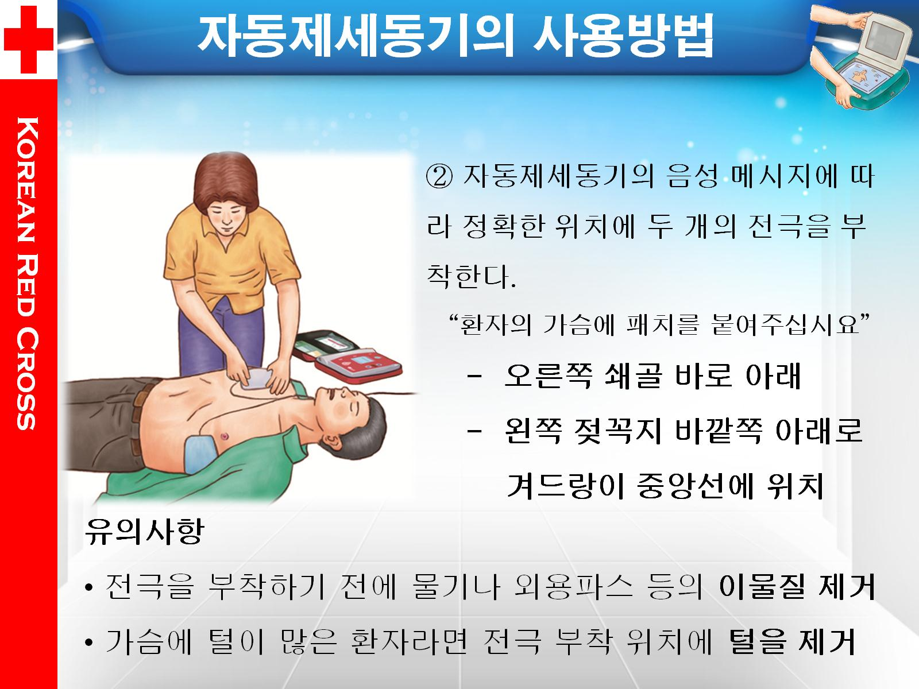
AKorean Alpine Federation
ANation Civil Defense

Slide 7
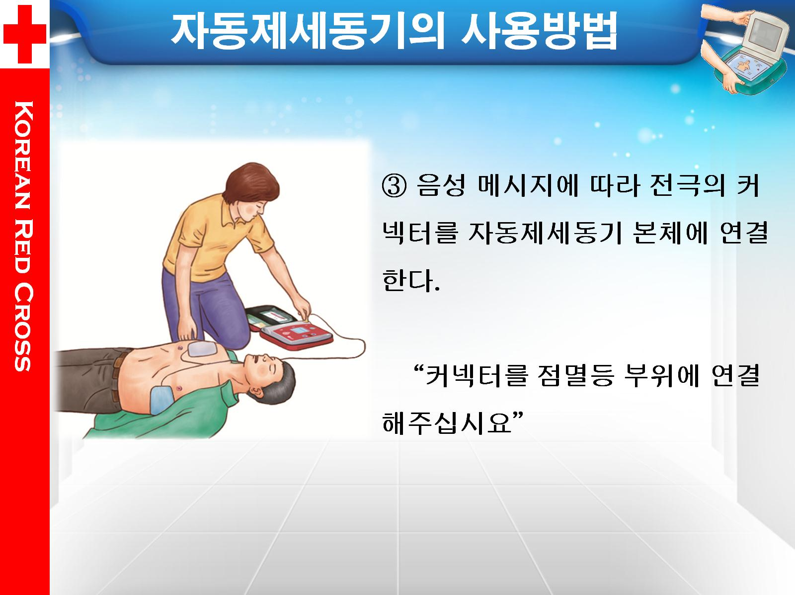
AKorean Alpine Federation
ANation Civil Defense

Slide 8
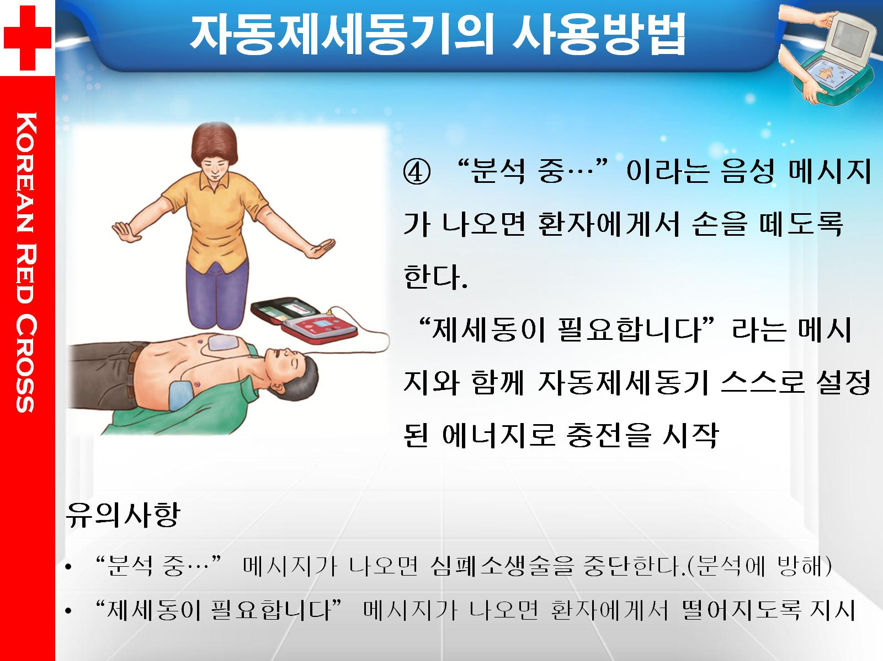
AKorean Alpine Federation
ANation Civil Defense

Slide 9
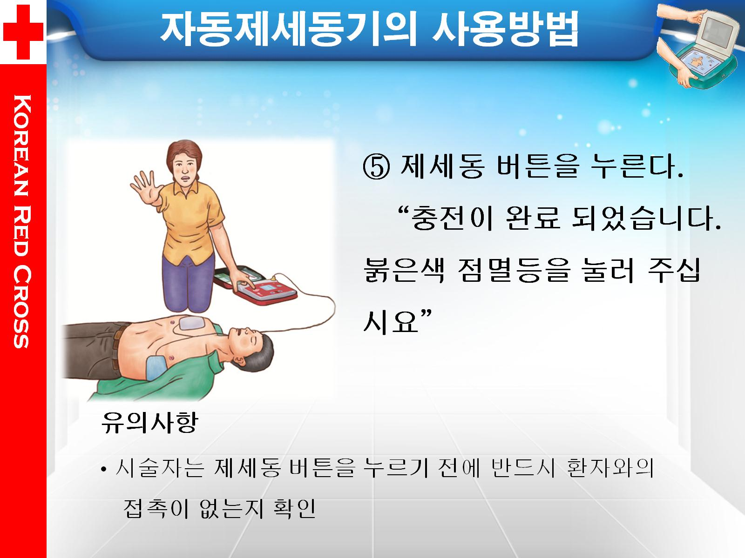
AKorean Alpine Federation
ANation Civil Defense

Slide 10
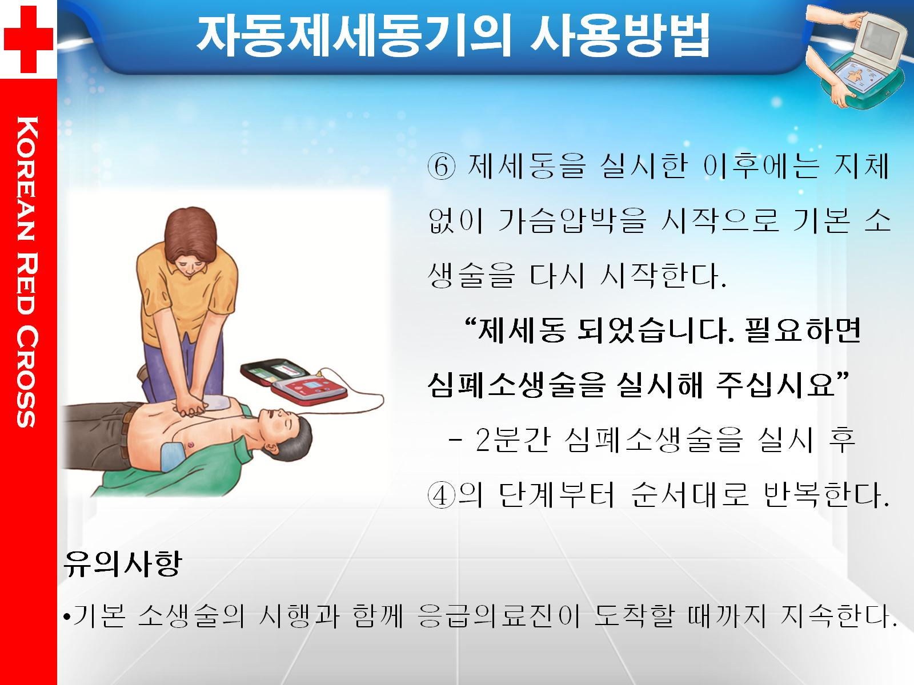
AKorean Alpine Federation
ANation Civil Defense

Slide 11
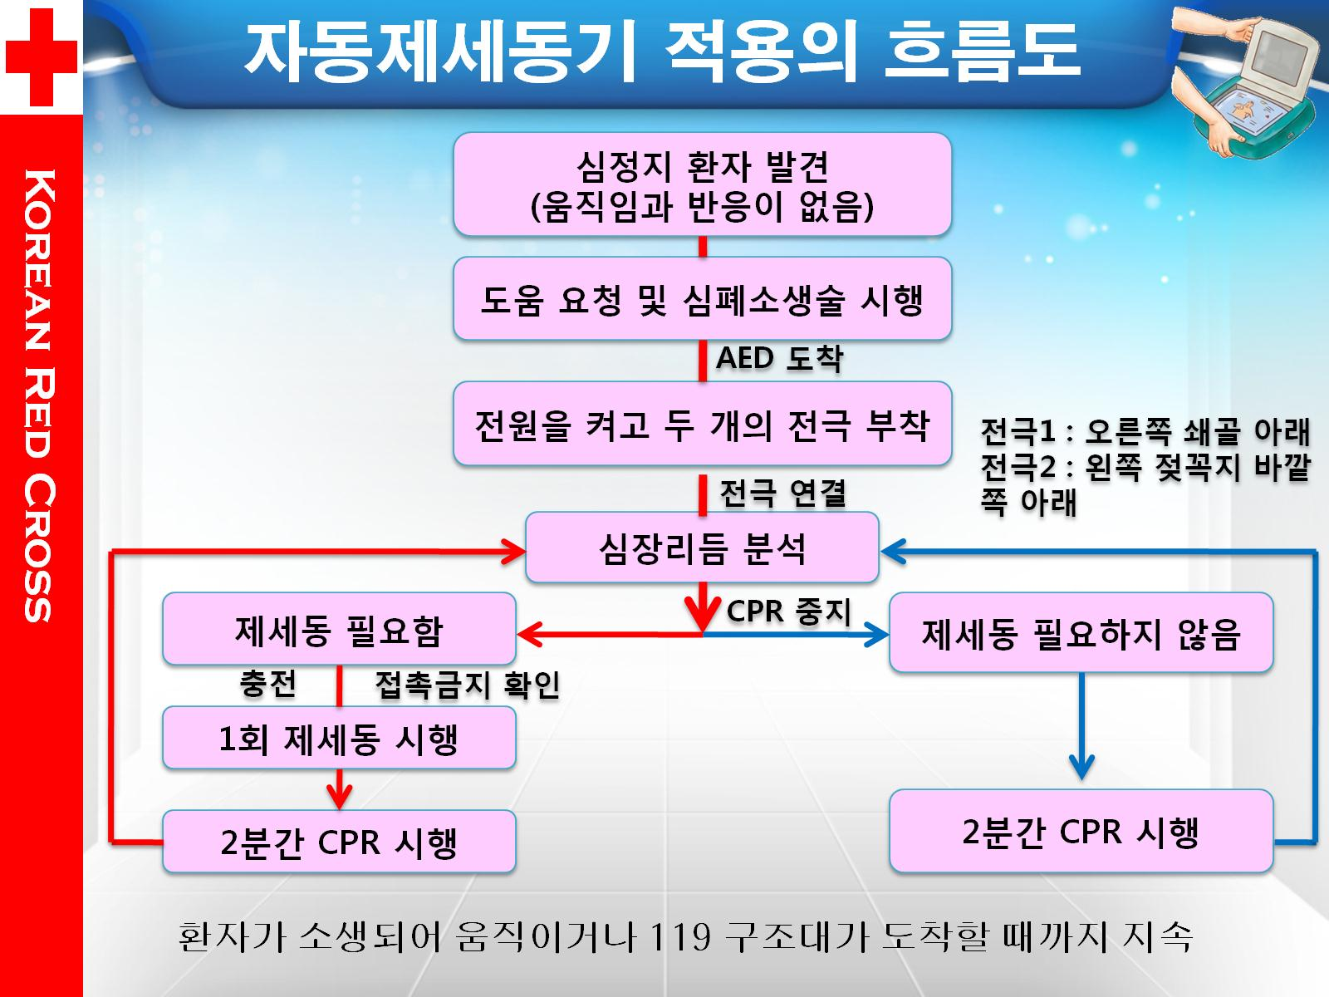
AKorean Alpine Federation
ANation Civil Defense

Slide 12
